Slide 1
OHSU SoM Faculty Development
Upcoming Opportunities
UPDATED: November 18, 2024

Slide 2
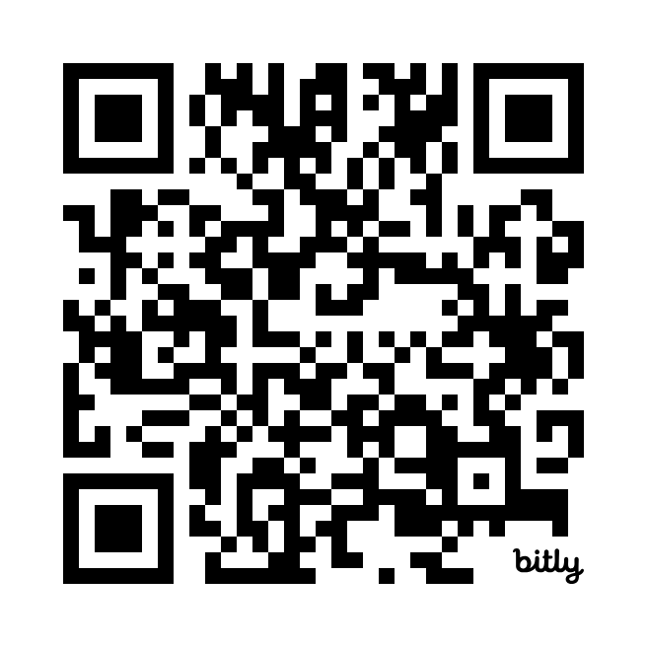
Mid-Career Clinical Leadership Development Program (MCCLDP) & Paths to Leadership (PTL)
Applications for 2025 Cohorts are now OPEN! Deadline is November 18.
CV/Educator’s Portfolio Drop-in Sessions: Bring your CV/EP and get feedback from experienced faculty!
February 14, April 28
Faculty Development Fridays
December 6, noon – 1:30 p.m. | Digital Accessibility: The Why, What, and How
New Faculty Foundations: Building for Success
December 9, noon – 2 p.m. | Living the values of diversity, equity, inclusion and belonging
Early Career Advancement Program
December 12, noon – 1:30 p.m. | Self, Time, & Project Management
Symposium on Educational Excellence
Call for Proposals now open! Deadline is December 31

Slide 3
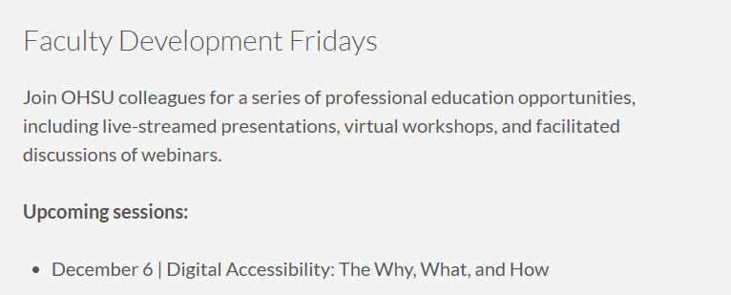
School of Medicine Faculty Development Website
https://www.ohsu.edu/school-of-medicine/faculty-development

