Slide 1
OHSU SoM Faculty Development
Upcoming Opportunities
UPDATED: December 16, 2024

Slide 2
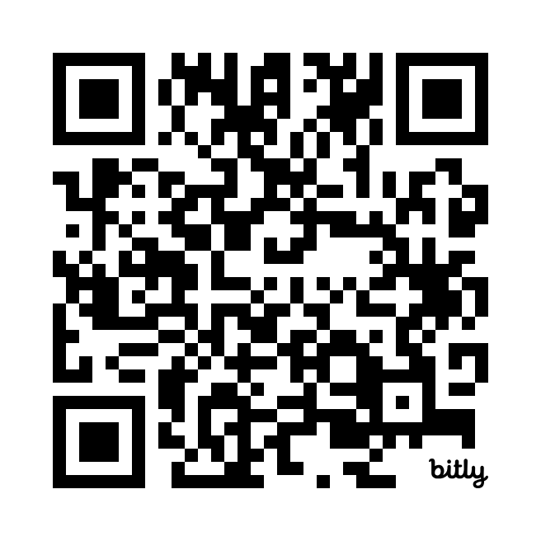
Symposium on Educational Excellence
Call for Proposals now open! Deadline is December 31 | Submit proposal
Early Career Advancement Program
January 9, noon – 1:30 p.m. | Business of Lab Management: Focus on the Money
New Faculty Foundations: Building for Success
January 13, noon – 2 p.m. | Skill development for educators and scientists
Faculty Development Fridays
January 17, 2025, noon – 1 p.m. | OCIC Reporting Pathways and Processes
CV/Educator’s Portfolio Drop-in Sessions: Bring your CV/EP and get feedback from experienced faculty!
February 14, April 28

Slide 3
School of Medicine Faculty Development Website
https://www.ohsu.edu/school-of-medicine/faculty-development

